Slide 1


Oracle Corporation
Presented by: Devansh Rawat
Linkedin:https://www.linkedin.com/in/devansh-rawat-170649268/
Section: G1
Roll no. : 12
Exploring the world's leading enterprise technology company through the lens of people, environment, structure, and excellence.

Slide 2


About Oracle: Pioneering Enterprise Technology Since 1977
The Beginning
Today's Oracle
Founded in 1977 by visionary entrepreneurs Larry Ellison, Bob Miner, and Ed Oates, Oracle revolutionised database management systems.
Industry Focus: Software, Cloud Computing, Database Solutions
Annual Revenue (2024): Approximately $50 billion
Core Products: Oracle Database, Oracle Cloud Infrastructure (OCI), Java, Fusion Applications
Headquarters: Austin, Texas, USA
"Integrated Cloud Applications and Platform Services" — delivering enterprise solutions that power global industries.
Global Workforce: 150,000+ employees across 175+ countries

Slide 3





Industry Leadership & Market Position
Database Dominance
Cloud Competition
Top 3 Globally
Oracle remains the undisputed leader in database technology and enterprise software, setting industry standards for reliability and performance.
Competing fiercely with AWS, Microsoft Azure, and Google Cloud in the rapidly evolving cloud infrastructure market.
Ranked among the top 3 global enterprise software providers, trusted by Fortune 500 companies worldwide.
Oracle's client portfolio includes industry giants such as HSBC, AT&T, BMW, and Indian Railways, demonstrating trust in Oracle's data security, cloud reliability, and AI-driven analytics capabilities.

Slide 4



Internal Structure: Leadership & Organisation
CEO: Safra Catz
CTO: Larry Ellison
Key Departments
Leading Oracle's strategic vision and global operations
Driving innovation and technological advancement
Cloud Infrastructure, Product Development, HR, Sales, Marketing, and Consulting
Organisational Philosophy
Global Coordination
Oracle's structure emphasises clear leadership hierarchies whilst maintaining agile, cross-functional teams that can respond quickly to market demands and technological shifts.
With operations spanning 175+ countries, Oracle leverages advanced communication technologies and regional hubs to ensure seamless collaboration across time zones.

Slide 5

Work Culture: Innovation Meets Inclusion
Collaboration & Learning
Oracle prioritises continuous learning through Oracle Learning platforms, ensuring employees stay ahead in rapidly evolving technologies like AI, cloud computing, and data analytics.
Hybrid Work Model
Embracing flexibility with global hybrid teams, Oracle supports work-life balance whilst maintaining productivity through cutting-edge collaboration tools and clear communication protocols.
Diversity & Inclusion
A commitment to building diverse teams across gender, ethnicity, and background creates an environment where innovation thrives through varied perspectives and experiences.
Ethics & Sustainability
Oracle champions data ethics, transparency, and environmental sustainability, embedding responsible practices into every aspect of business operations.

Slide 6




Why Oracle? A Personal Perspective
Passion for Technology
My deep interest in software engineering and database systems aligns perfectly with Oracle's core expertise and industry-leading innovations.
Legacy of Innovation
Oracle's pioneering work in enterprise technology and AI innovation represents the cutting edge of what's possible in modern computing.
Employee-First Culture
The company's commitment to employee development, well-being, and career growth creates an environment where professionals can truly excel.
Global Impact
Oracle's solutions power critical infrastructure worldwide—from banking to transportation—offering the opportunity to make a meaningful difference on a global scale.
The unique combination of technology, continuous learning opportunities, and visionary leadership makes Oracle an ideal organisation for long-term career growth and impact.

Slide 7




People Needs: Current & Future Requirements
AI & Cloud Upskilling
Hybrid Team Engagement
Wellness & Inclusivity
As cloud and AI technologies evolve rapidly, employees need continuous training programmes to master emerging tools like machine learning, advanced analytics, and next-generation cloud architectures.
With distributed teams across continents, Oracle must enhance virtual collaboration tools, foster team bonding, and maintain company culture despite physical distances.
Supporting employee mental health, physical well-being, and creating truly inclusive spaces where every voice is heard and valued remains a critical priority.
Strategic Focus: Oracle recognises that investing in people directly translates to innovation, retention, and competitive advantage in the technology sector.

Slide 8

HR Challenges: Navigating Complex Landscapes
Talent Competition
Global Productivity
Competing with tech giants like Google, Amazon, and Microsoft for top engineering and data science talent requires innovative recruitment strategies and compelling value propositions.
Managing productivity and maintaining quality standards across 175+ countries with diverse work cultures, time zones, and regulatory environments presents ongoing challenges.
Retention Strategy
Retaining skilled employees in a fast-evolving tech landscape where skills quickly become obsolete demands continuous learning opportunities and clear career progression paths.
Oracle's HR department must balance competitive compensation, meaningful work, professional development, and company culture to attract and retain the best talent in an increasingly competitive market.

Slide 9

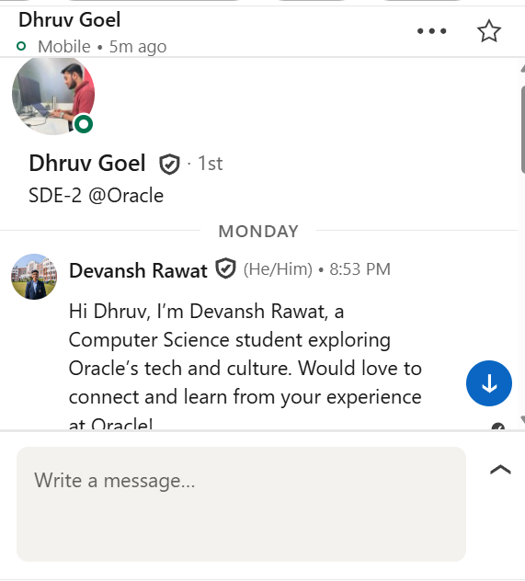
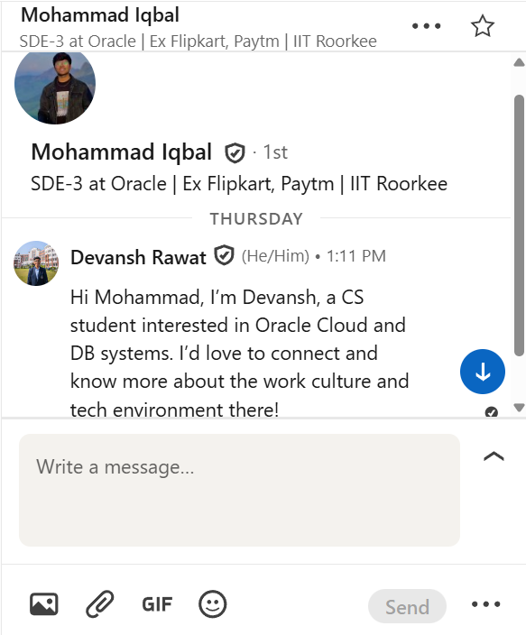

Employee Insights: Real Voices from Oracle
Mohammad iqbal
Dhruv goel
SDE-3 at Oracle, Bengaluru, Karnataka, India
SDE-2 @Oracle, Bengaluru, Karnataka, India
"Hi Devansh! Great to connect with you. Oracle Cloud is a fantastic place to grow — there’s a strong focus on learning, collaboration, and innovation. If you’re passionate about cloud and database systems, you’ll definitely enjoy exploring opportunities here!”
"Hi Devansh, great question! At Oracle, teams are encouraged to innovate while maintaining strong reliability standards. There’s a great balance of creativity, collaboration, and technical depth here — it’s what makes the culture so rewarding.”
LinkedIn: linkedin.com/in/mohammad-iqbal-30b474137/
LinkedIn: linkedin.com/in/dhruv-goel-70b6a4183/
These insights, gathered through professional networking and research, provide authentic perspectives on Oracle's work environment, culture, and employee experience.

Slide 10
Key Takeaways: Oracle's People Excellence
Industry Leadership
People-First Culture
Oracle maintains its position as a top 3 global enterprise software provider through continuous innovation in database technology, cloud infrastructure, and AI-driven solutions.
Commitment to employee development, hybrid flexibility, diversity, and wellness creates an environment where talent flourishes and innovation thrives.
Strategic Challenges
Future Outlook
Addressing talent competition, global coordination, and continuous upskilling remains critical for sustaining Oracle's competitive advantage in the rapidly evolving tech landscape.
With 150,000+ employees driving $50 billion in revenue, Oracle's focus on integrated cloud applications and platform services positions it perfectly for continued growth and impact.
Learn More: www.oracle.com
Thank you for your attention.

